Slide 1


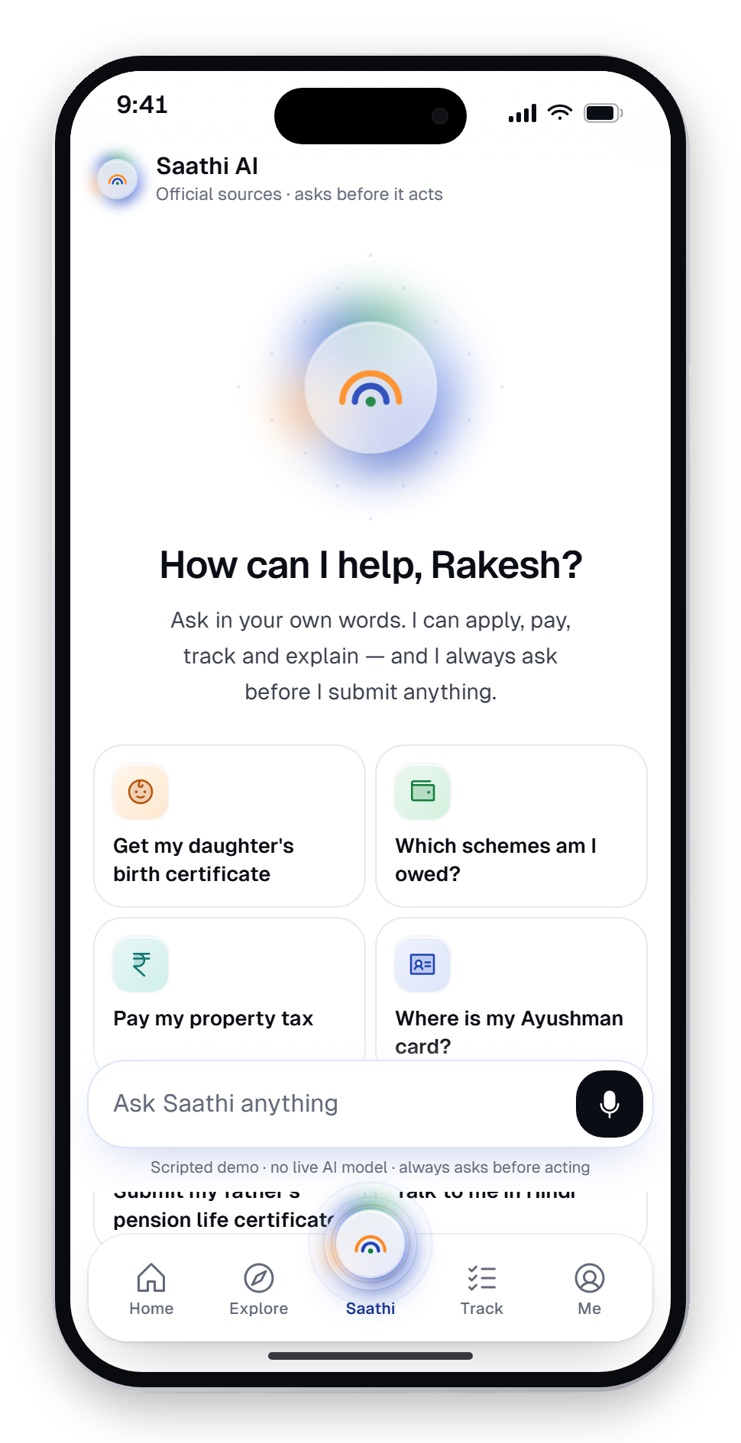
साथी
SAATHI
Project Expo 2026 · Chandigarh University
Project ID · CUPE4-ENT-UIC-157
Project Expo 2026 · Chandigarh University
Smart City Citizen
Services App
Saathi — one door to every government service. A multilingual, voice-first citizen app with an assistant that asks before it acts.
SUBMITTED BY
DEPARTMENT
Krishom Sharma
UIC
BCA (UI/UX Designs)
University Institute of Computing
UID — 24BCU10002
A design concept. Not affiliated with the Government of India.

Slide 2

One door to every government service.
IN ONE SENTENCE
हर सरकारी सेवा का एक द्वार।
Saathi is a smart-city citizen app that starts from your life, not from a department. Ask in your own language — it finds what you're entitled to, fills in the forms and keeps the receipts.
42
17
15
0
real processes
languages live
dept. consoles
actions without consent

Slide 3
What we'll cover
From a maze of apps to one trustworthy door — and the working prototype behind it.
01
The problem
07
Inclusion & trust
Hundreds of apps, three frictions
17 languages, 8 access modes, consent
02
Research & users
08
Design system & IA
Four personas from the field
Bharat Precision, five tabs
03
The solution
09
Technology
Saathi — one door, three lenses
Stack, architecture, India Stack
04
Built, not just designed
10
Innovation & impact
What exists and runs today
What's new, SDGs, Viksit Bharat
05
Saathi AI
11
Validation & roadmap
An assistant that asks before it acts
Targets, testing plan, 2026 → 2047
06
The product
12
Live demo
Citizen app, website, department consoles
A three-minute walkthrough for judges

Slide 4
Hundreds of apps. No single door.
A citizen of a smart city doesn't deal with one government. They deal with dozens.
Each service has its own app, login, language and idea of how a form should work. Finding the real one — not a lookalike, not a middleman — takes confidence, data and patience that the people who need help most often don't have.
“
मुझे पता है कि सब online है, but मुझे ये नहीं पता कि कौन सा online असली है.
A FEW OF THE APPS A CITIZEN IS EXPECTED TO JUGGLE
“I know everything's online — I just don't know which ‘online’ is the real one.”
UMANG
DigiLocker
mAadhaar
mParivahan
e-Shram
DigiYatra
Ayushman
EPFO
NSP
Bhulekh
PFMS
Income Tax
Rakesh, 34 — shopkeeper, Kanpur · user research

Slide 5






The rails are built. The door is missing.
India runs the largest digital public infrastructure in the world — and still lacks a front door.
142 crore+
23.2 billion
70 crore+
Aadhaar numbers issued
UPI payments in May 2026 alone
DigiLocker accounts
THREE FRICTIONS HEARD AGAIN AND AGAIN
Language
Trust
Where to start
Forms fall back to English; many citizens read slowly or in another script.
Fake portals sit one search away; middlemen charge for confidence.
Services are sorted by department; people think in life events.
Sources: Aadhaar IDs (Apr 2025) · NPCI UPI data, May 2026 · DigiLocker users 2026 — as cited on the Saathi website.

Slide 6
Four people. Four very different needs.
Personas from conversations in cities, small towns and villages.
RV
SD
VS
AS
Rakesh Verma
Sunita Devi
Vikram Singh
Ananya Sharma
34 · Tier-2 · Kanpur
29 · Rural · Bihar
68 · Senior · Chennai
26 · Urban · Bengaluru
Shopkeeper, burned by fake-portal scams.
Farmer, low literacy, one shared phone.
Retired teacher, prefers Tamil.
Analyst, zero patience for friction.
“If it looks official, I still double-check. Twice.”
“I can speak it. I can't always read it.”
“Don't hurry me. Just tell me clearly.”
“If it takes more than the train ride, I'll abandon it.”

Slide 7

Design one trustworthy, multilingual door to every city service — that starts from the citizen's life, not from a department?
HOW MIGHT WE
For Rakesh, Sunita, Vikram and Ananya — and every citizen who has stood in the wrong queue.

Slide 8
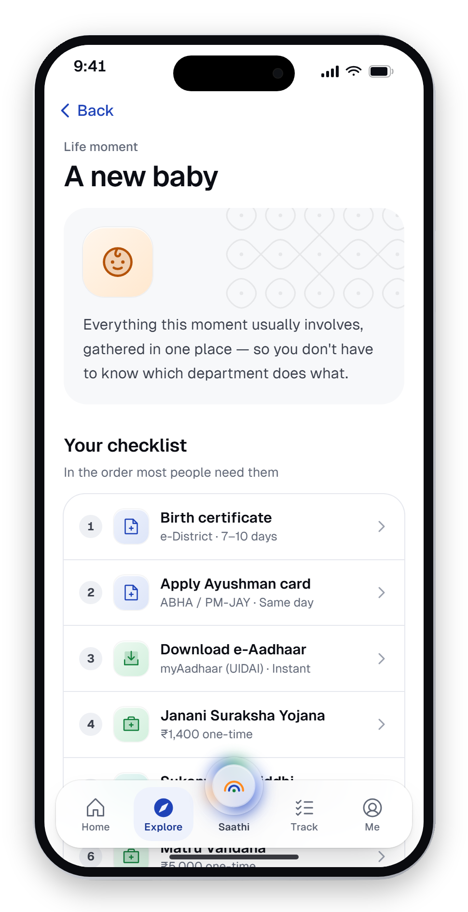
Saathi — one door
Citizens don't think in departments. They think in moments, needs and entitlements.
A birth, a job, a move
Life moments bundle every department involved
Moments
Needs
A document, a payment
Needs get you to the right form in two taps
Citizen
Schemes and pensions
Entitlements show what you're owed — and why
Tell Saathi what you need
Entitlements
The assistant routes any words, any language

Slide 9







Built, not just designed
Everything below exists and runs in the browser today.
42
17
15
6
government processes modelled on their real portals
languages live — 6 more of the Eighth Schedule coming
department consoles for officers
AI missions, each ending in a real outcome
10
8
4
₹0
onboarding steps, incl. DPDP-style consent
accessibility modes, on by default
surfaces: app, website, consoles, design system
software cost — an open-source stack

Slide 10






Eight modules, one experience
Every module is built and clickable in the prototype.
Onboarding
Home
Explore
Saathi AI
Language, Aadhaar, OTP, consent, profile, accessibility
Identity card, needs-attention nudges, schemes for you
Life moments, services and schemes, on-device search
Plans, shows sources, asks consent, then acts
Apply engine
Track
Me & privacy
Dept. consoles
42 flows: voice fill, documents, review, receipt
Stages, named officers, SLAs, “why the delay?”
Document wallet, family proxy, access log, revoke
Review, verify, decide — live to the citizen

Slide 11






Key flow — Saathi AI asks before it acts
Rakesh asks for his daughter's birth certificate, in Hindi. Four steps, one consent, real proof.
01
Ask
02
Plan
03
Approve
04
Done
मेरी बेटी का जन्म प्रमाणपत्र बनवाना है
Fetch the hospital birth record from DigiLocker
Share with Nagar Nigam, Kanpur?
Application submitted
Fill Form 1 for e-District
Your name and address
SAA-2026-457029
Aanya's hospital birth record
Priya Nair is reviewing it
“I need to get my daughter's birth certificate”
Certificate expected in 7 days
Check Janani Suraksha Yojana eligibility
Valid until the application closes
You may also get ₹1,400 under Janani Suraksha Yojana.
By voice or text, in any of 17 languages
Submit to Nagar Nigam, Kanpur
Approve
Edit
Nothing leaves the phone without a yes
Every step names its official source

Slide 12




Guardrails, and what happens when it can't help
Acting on someone's identity and money raises the bar for trust. Every pattern keeps the citizen in control.
GUARDRAILS, BUILT IN
DESIGNED FAILURE STATES
Official sources only
Didn't understand
Every answer names its department or portal.
Offer three likely requests in plain words — and a person.
Asks before it acts
Not eligible
Never submits, pays or shares without approval.
Say so plainly, name the rule, suggest what may apply instead.
Explains itself
Service unavailable
“Why you qualify” for every scheme it suggests.
Keep the application as a draft; never lose what was entered.
A person is close
Needs a human
One tap reaches a CSC or a helpline.
Hand over to the nearest CSC with the context filled in.
Pre-scripted, not a live language model — so every answer can be reviewed before it reaches a citizen.

Slide 13
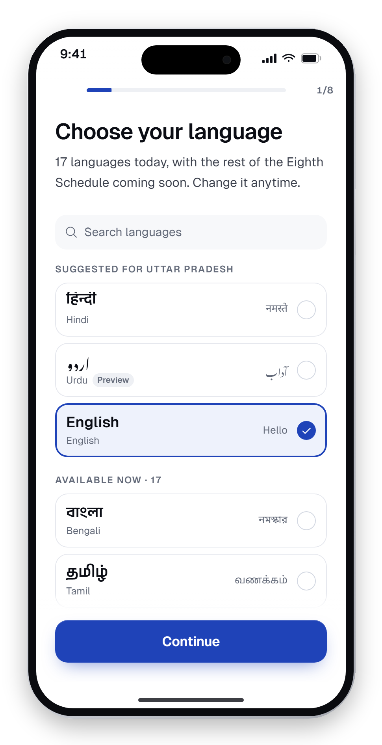
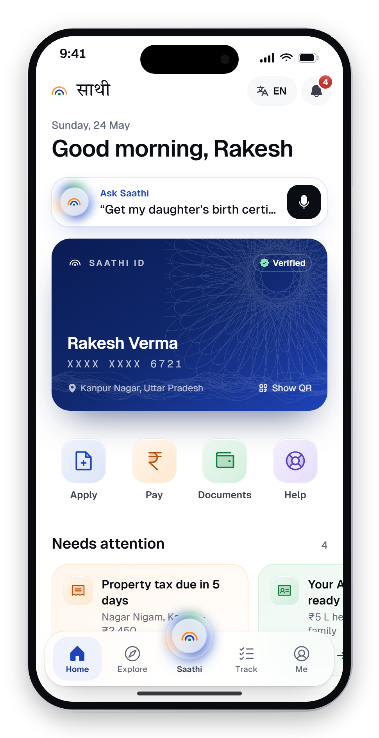
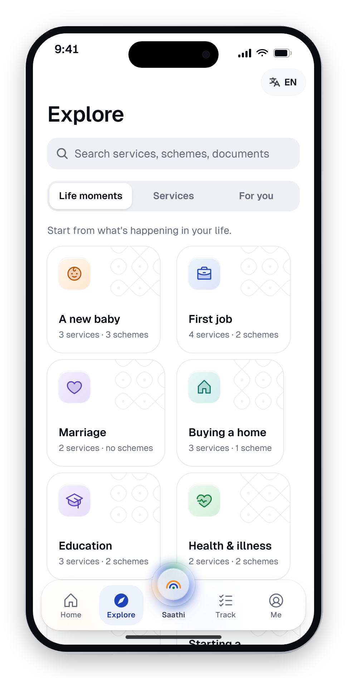
The citizen app
Onboarding with consent, a home that knows what needs attention, services found by life moment.
Onboarding
Home
Explore
A new baby
Language first — 17 today
Identity, nudges, applications
Life moments, services, schemes
One checklist, many departments

Slide 14
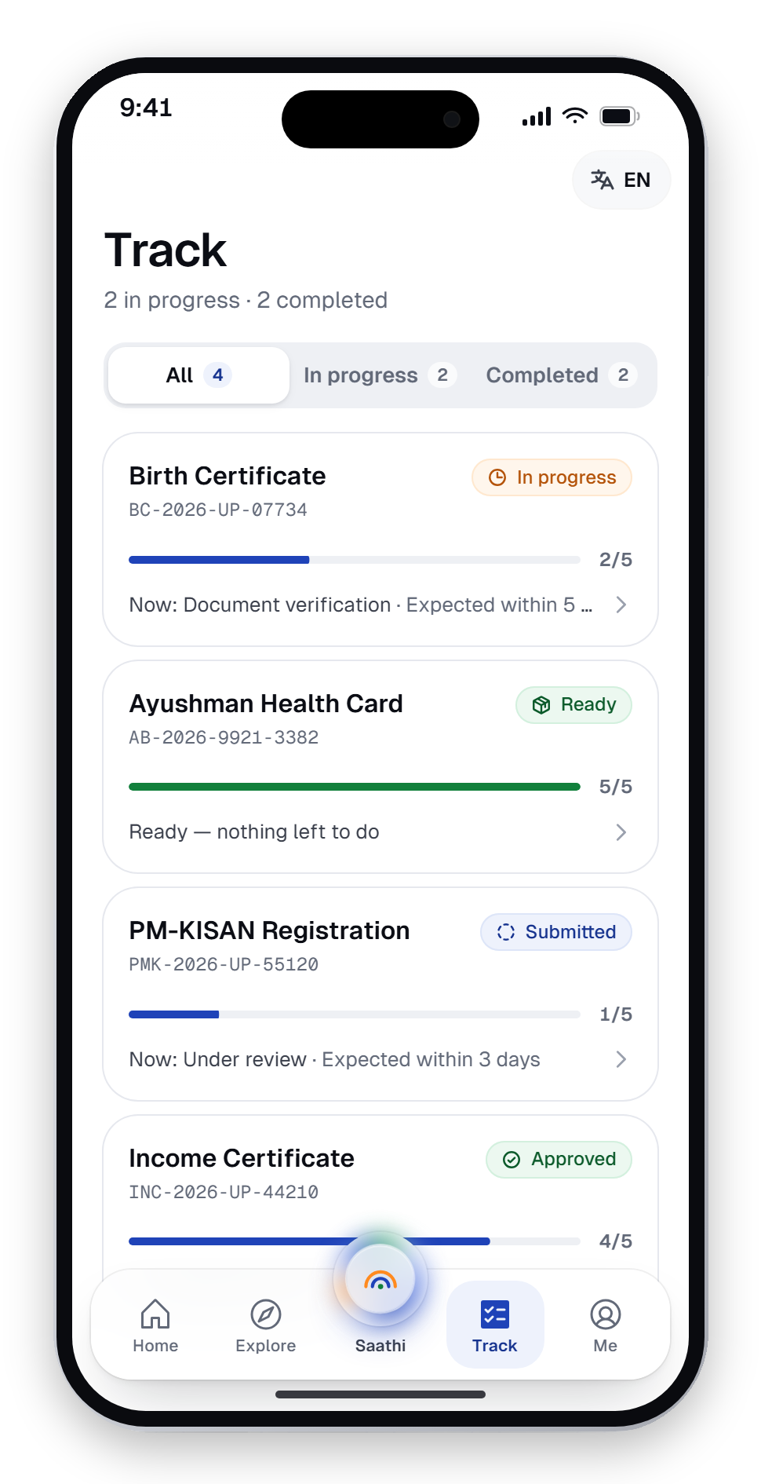
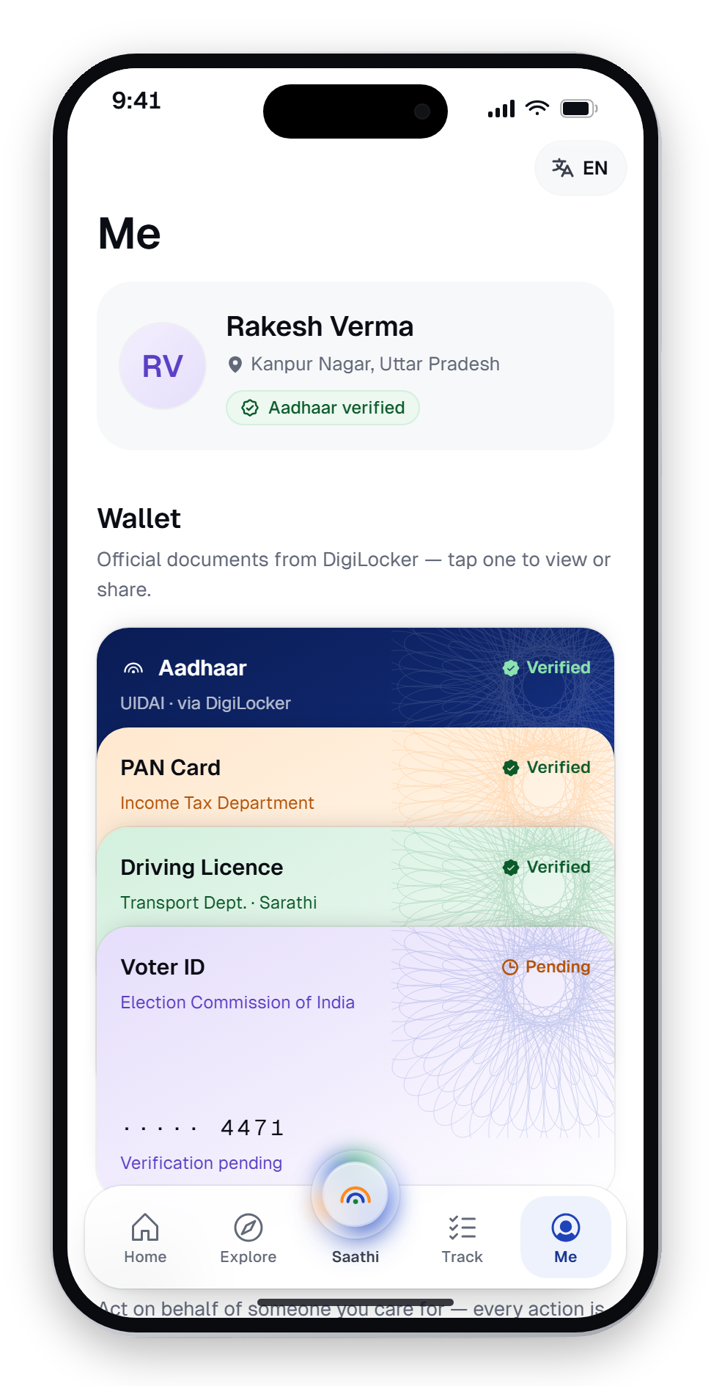
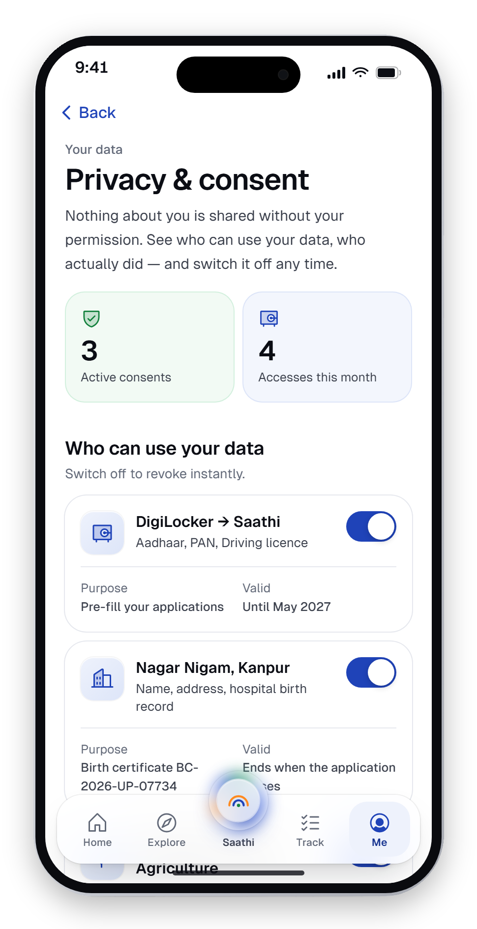
Where trust is earned
The assistant, the timeline, the wallet and the privacy dashboard.
Saathi AI
Track
Me
Privacy & consent
Ask in any words
Stages, officers and dates
Tinted document wallet
Who used your data — revoke

Slide 15
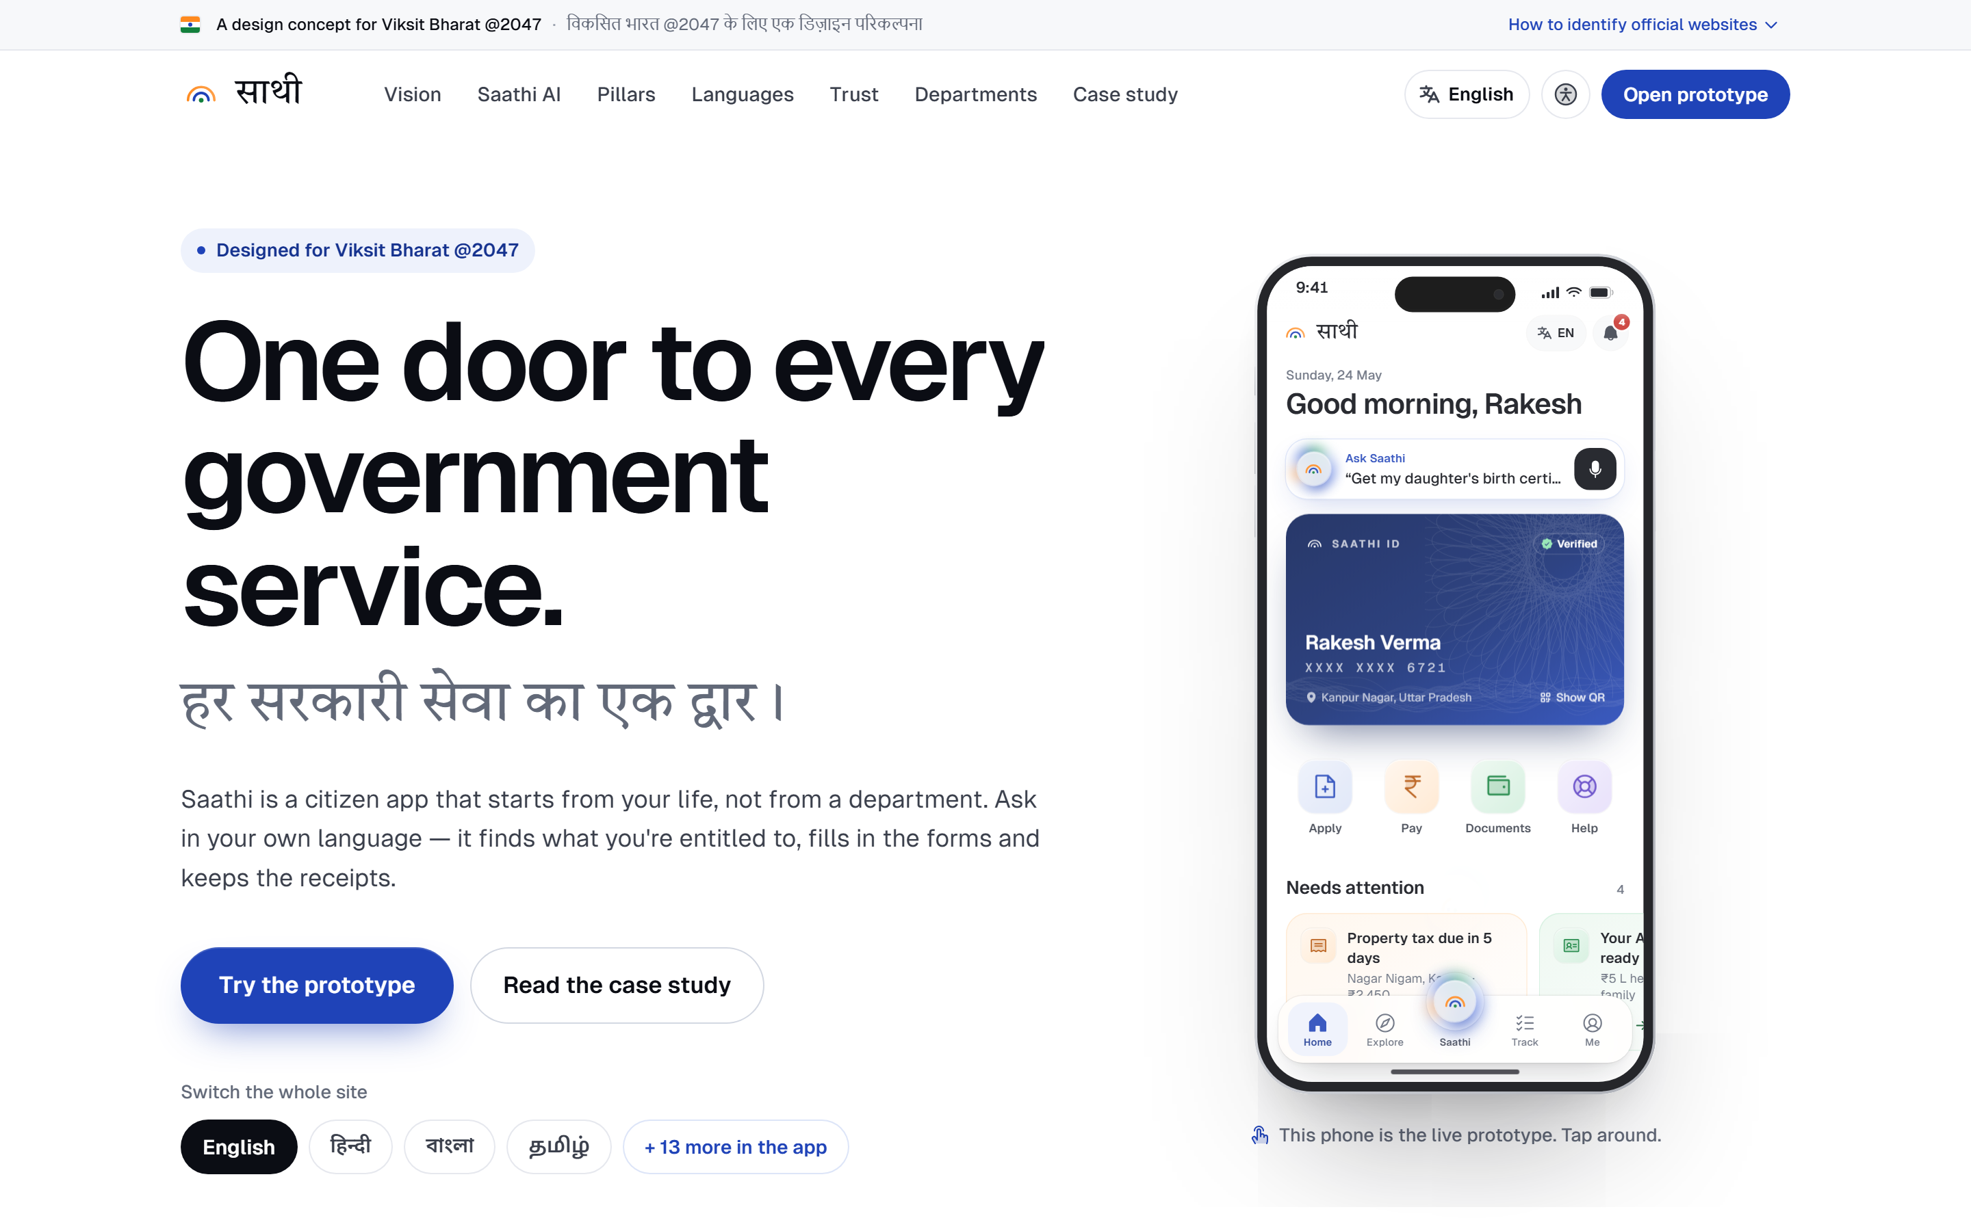
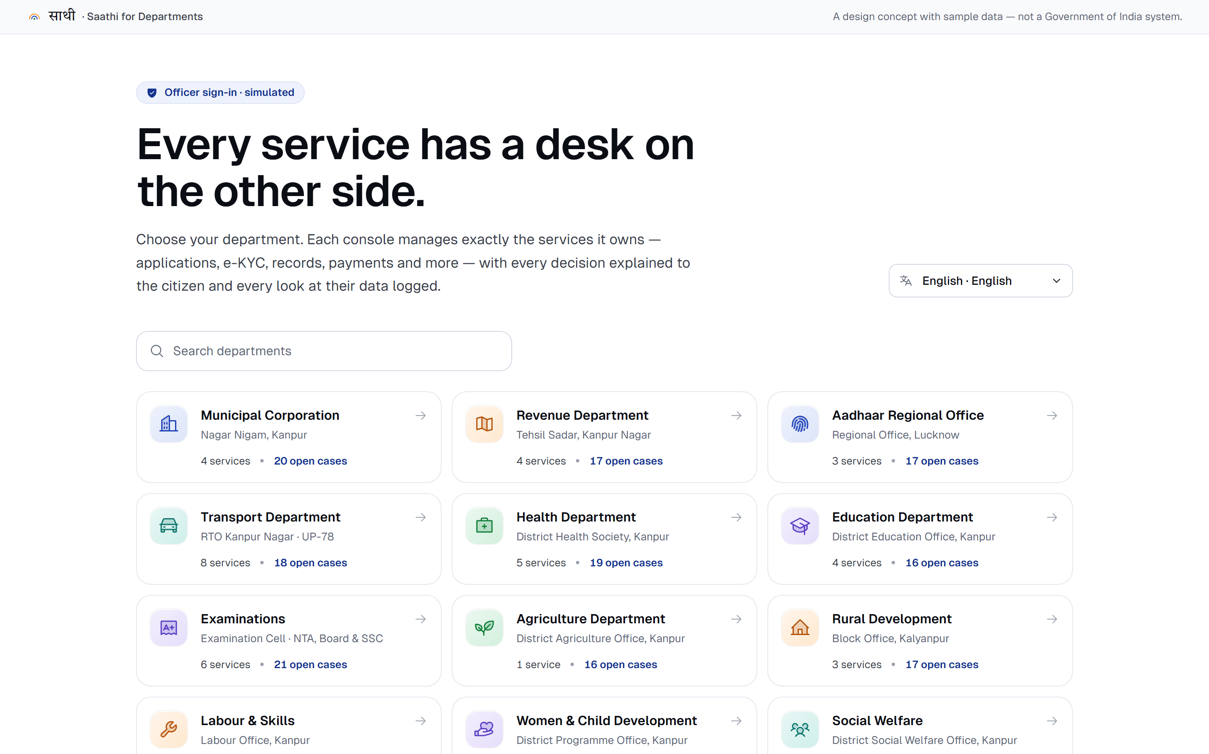
Both sides of the counter
The citizen's website and the officer's console — every decision reaches the citizen live, in their language.
Website — “One door to every government service”, with the live prototype embedded
Saathi for Departments — 15 consoles, masked e-KYC, audit trail

Slide 16








It speaks the way India speaks
17 languages and eleven scripts today, left to right and right to left — with 8 accessibility modes on by default.
Voice on every field
Read aloud
“HOW CAN I HELP?”
मैं कैसे मदद करूँ?
Hindi
আমি কীভাবে সাহায্য করতে পারি?
Bengali
Slow mode
Larger text
நான் எப்படி உதவலாம்?
Tamil
నేను ఎలా సహాయం చేయగలను?
Telugu
હું કેવી રીતે મદદ કરી શકું?
Gujarati
Family / proxy mode
Weak-signal ready
ನಾನು ಹೇಗೆ ಸಹಾಯ ಮಾಡಲಿ?
Kannada
ഞാൻ എങ്ങനെ സഹായിക്കാം?
Malayalam
ਮੈਂ ਕਿਵੇਂ ਮਦਦ ਕਰ ਸਕਦਾ ਹਾਂ?
Punjabi
Colour-blind safe
Screen-reader ready
Hindi, Bengali, Tamil hand-authored · 13 machine-assisted, flagged for native review · 6 coming soon

Slide 17



Trust you can check
People told us they double-check every government website. Saathi is designed so they can.
Consent before data moves
Every share names who asks, what they get, why and until when — shaped by the DPDP Act, 2023.
A record of every access
See which officer opened your documents, when and why. Revoke with one switch.
Proof you can verify
Every action ends with a reference you can check on the official portal.
No ads. No dark patterns.
A public service should never compete for your attention.
Designed to WCAG 2.1 AA, GIGW 3.0 and UX4G guidelines.

Slide 18




Design system — Bharat Precision
Calm enough to trust with a pension, precise enough to feel world-class.
COLOUR WITH A JOB
Kolam & guilloche
TYPE ACROSS SCRIPTS
Chakra Navy
Aa
Precision.
Imagery made in code — kolam line art and security linework. No stock photos, no maps.
#1F43B8 · Actions, links, focus
India Green
Phosphor, one family
#12803C · Verified, approved, done
साथी
நான் உதவலாம்
Regular for chrome, duotone for tiles, fill for the active tab.
Saffron
#FF8A1F · Highlights — never body text
Geist for Latin UI · Instrument Serif for one emotive word · Anek (Ek Type, an Indian foundry) for Indic headlines · Noto Sans for Indic body at 1.8 line-height (UX4G) · Tiro Devanagari for the wordmark.
Motion with a reason
Ink
UI motion under 300 ms, always interruptible; fades only for reduced motion.
#0B0D14 · Text
White
Contrast, tested
#FFFFFF · Every surface
Every text colour checked ≥ 4.5:1 against WCAG 2.1 AA in automated tests.

Slide 19




Information architecture
Five tabs. A bare “Apply” tab asks “apply for what?” — so the centre of Saathi is the assistant.
साथी Saathi
Home
Explore
Saathi AI
Track
Me
Saathi ID card
Life moments
Ask by voice or text
Applications
Document wallet
Needs attention
Services (42 flows)
Plan & sources
Status timeline
Family / proxy
My applications
Schemes
Consent gate
Named officers
Privacy dashboard
Schemes for you
Search, any language
Outcome + receipt
“Why the delay?”
Language & access

Slide 20




Architecture & stack
A static, fast, testable build — runs in any browser, no install, deployable to any city.
Experience
Next.js 14 · React 18 · TypeScript · Tailwind CSS · Framer Motion · Phosphor Icons
BUILT ON INDIA STACK (CONCEPTUAL)
Aadhaar
Proves it's you
Language
next-intl · 23 locale folders · per-script fonts and line-heights · 200 ms script swap
DigiLocker
Brings verified documents
Logic
Scripted agent: intents → missions → player · consent pause · side effects into app state
UPI
Pays fees and dues
Bhashini
Speaks your language
Quality
Vitest: intent matching per language, sequencing, consent gate, contrast ratios
API Setu
Talks to departments
CPGRAMS
Escalates complaints
Delivery
Static export on Hostinger · Lighthouse budget ≥ 90 perf / ≥ 95 a11y · no 3D libraries
Not affiliated with these platforms.

Slide 21




What's new here
Six ideas that set Saathi apart from today's government apps, including UMANG.
Life-moment bundling
An agent with a consent gate
Vernacular-first, not translated
A new baby brings birth certificate, JSY and Sukanya Samriddhi as one checklist.
Plans, cites official sources and acts only after an explicit “yes”.
Designed in Hindi and Tamil first; the whole UI swaps script in 200 ms.
Both sides of the counter
Visible data access
Proxy as a first-class action
Officer consoles push decisions to the citizen's app, live and in their language.
A privacy dashboard shows who opened your documents — revoke in one tap.
Help a parent or child with a persistent “helping Sunita” banner.

Slide 22
Impact — Viksit Bharat & the SDGs
Development measured by the lives it changes — Garib, Yuva, Annadata and Nari.
गरीब
युवा
अन्नदाता
नारी
Garib
Yuva
Annadata
Nari
Entitlements find people. Ramesh, 67, has his life certificate submitted by his son — no queue, no agent.
Ananya renews her driving licence on a twenty-minute train ride.
Sunita asks out loud and hears her PM-KISAN instalment status read back.
After Aanya is born, the certificate, JSY and Sukanya Samriddhi arrive together.
UN SUSTAINABLE DEVELOPMENT GOALS SERVED
Sustainable cities & communities
Strong, accountable institutions
Reduced inequalities
Innovation & infrastructure
SDG 11
SDG 16
SDG 10
SDG 9

Slide 23



How we'd know it works
Design targets for a pilot — not results — and the plan to prove them.
5 min
90%
0
1 in 3
to apply for a birth certificate, from a first tap
complete a key flow without help
submissions or payments without consent
fields filled by voice, low-literacy users
Usability testing in three states
Native-language review
Moderated sessions with each persona, in their language, on their own phones.
Every language reviewed by native speakers — the 13 machine-assisted first.
Independent accessibility audit
Assistant red-teaming
Screen reader, keyboard, low vision, cognitive load — WCAG 2.1 AA, GIGW 3.0.
Try to make Saathi submit, pay or share without consent — fix every path.

Slide 24
Roadmap to 2047
From a working prototype to a companion for every citizen. Future milestones are design targets.
2026
2027
2030
2040
2047
Saathi, designed
City pilot
Pilot in three states
Every district
Viksit Bharat
One door to every service, as a working prototype.
One smart city: municipal, RTO and health desks live.
Tested with the people it's for, in their languages.
All 22 scheduled languages, online and offline.
A government that feels like a companion.
Design target
Design target
Design target
Design target
Deployment model (proposed): a city-by-city rollout through municipal corporations, built on India Stack — a static front end any city can host.

Slide 25


Live demo — three minutes
A walkthrough for judges. Everything in the prototype works.
01
Onboard in Hindi
Pick हिन्दी — the whole app re-typesets instantly. Approve the consent screen.
02
Ask Saathi for a birth certificate
Watch it plan, cite DigiLocker and e-District, then wait for your Approve.
03
Pay property tax
Dues fetched, UPI consent, a verifiable receipt with a reference number.
04
Switch to the department console
Approve the case as Nagar Nigam — see the citizen's Track update live.
05
Revoke a consent
Open the privacy dashboard, see who accessed your data, switch it off.

Slide 26

Conclusion & future scope
A smart city is judged at its counters. Saathi puts one door in front of all of them.
01
The problem
FUTURE SCOPE
Hundreds of disconnected apps; language, trust and “where do I start?”.
Live Aadhaar, UPI and DigiLocker integrations
02
Speech recognition in every language via Bhashini
The answer
One door organised by life, an agent that asks first, both sides of the counter.
Offline-first data layer for weak networks
Native review of all 17 languages; the other 6 added
03
The proof
A working prototype: 42 processes, 17 languages, 15 consoles, 6 AI missions.
City pilot with a municipal corporation

Slide 27
Thank you. Questions?
साथी — your companion for every government service.
PROJECT EXPO 2026 · CHANDIGARH UNIVERSITY
Krishom Sharma
BCA (UI/UX Designs) · UID 24BCU10002
UIC — University Institute of Computing
Project ID CUPE4-ENT-UIC-157

